Slide 1


Slide 2
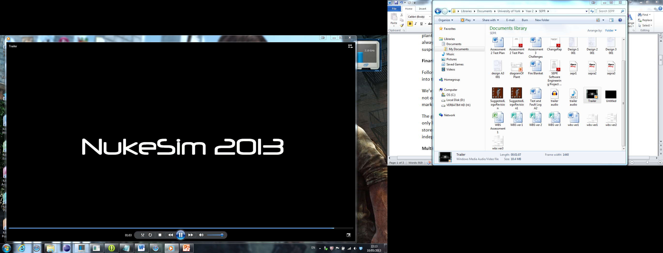

Slide 3




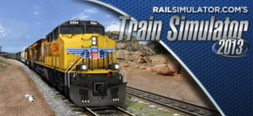


Slide 4
Cross Platform Multiplayer
Network Enabled System
Asymmetric Gameplay
Duel PC Experience

Slide 5
Three full length orchestral tracks
Myriad of Sound Effects
Proven Affect on Immersion
Fully Licensed for Distribution

Slide 6
Repeated Regression Testing
Comprehensive Unit Test Suite
Extensive Dynamic System Testing
34 User Acceptance Tests
Strenuous Exit Criteria

